Slide 1
Logo Craft :Innovative Logo Generator using Diffusion Technology
Logo Craft: Revolutionizing Logo Design with AI
Welcome to the future of logo design, where artificial intelligence meets creativity. This presentation explores the power of diffusion models and how Logo Craft is transforming the logo creation process.
Team Members :
K.Akshitha – 22B81A1205
Asima Shareef - 22B81A1208
G. Charitha - 22B81A1210
B.Sri Lakshmi – 22B81A1247
K. Vasavi - 22B81A1259
a

Slide 2
Understanding Diffusion Models
Forward Diffusion
Reverse Diffusion
Adding noise to an image until it becomes pure noise.
Learning to remove noise, gradually revealing the underlying image.

Slide 3

The Traditional Logo Design Process: Pain Points
Time-consuming iterations and revisions.
Limited availability and inconsistent quality of designers.
High costs for exploring different logo ideas.

Slide 4
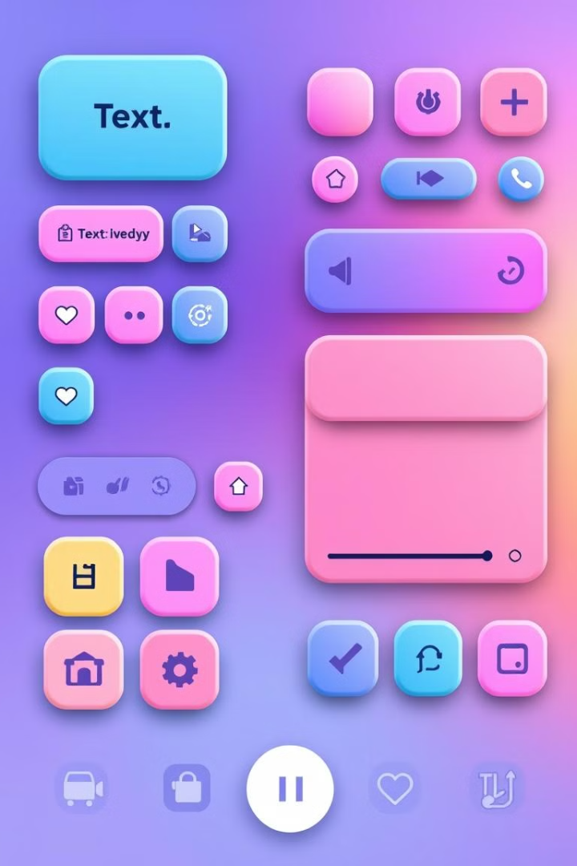
Logo Craft: The Solution
AI-powered logo generation platform.
User-friendly interface for input and customization.
Cost-effective for businesses of all sizes.

Slide 5
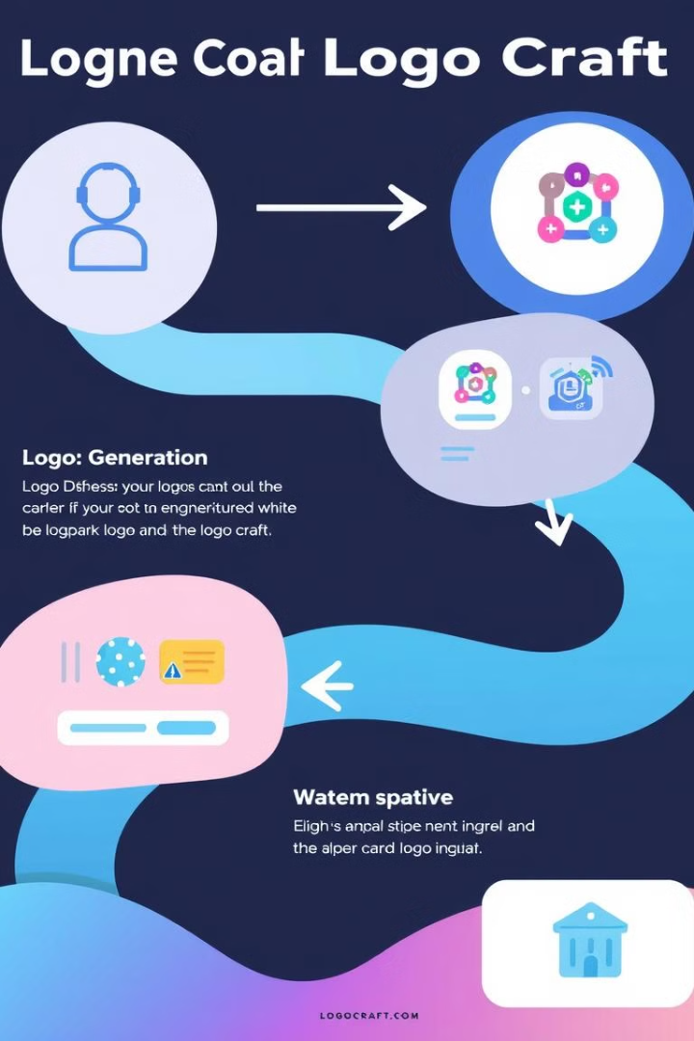
How Logo Craft Works: A Step-by-Step Guide
1
User input: Text prompts, style preferences, color palettes.
2
Diffusion process: AI generates diverse logo concepts.
3
Customization: Refine and personalize generated logos.
4
Download: High-resolution logo files in various formats.

Slide 6
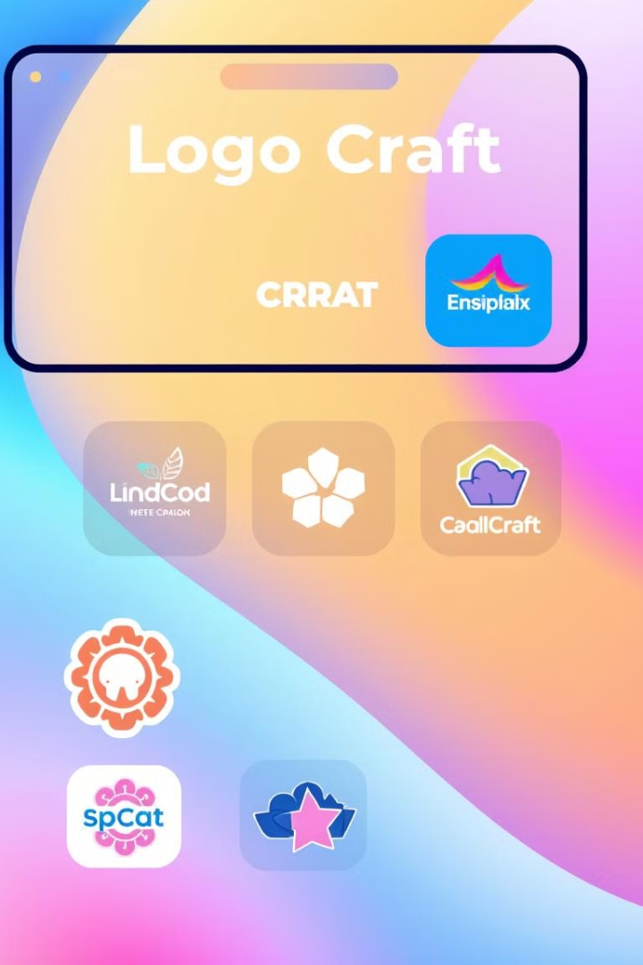




Key Features and Benefits
Generate dozens of concepts in minutes.
Create logos in any style, from minimalist to vintage.
Maintain a consistent look and feel across designs.
Reduce logo design costs by up to 80%.

Slide 7
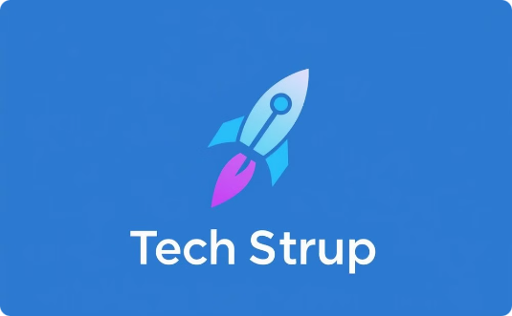


Case Studies and Success Stories
Startup X
E-commerce Brand Y
Local Business Z
Reduced logo design costs by 75%.
Increased brand recognition by 40%.
Created a unique logo that resonates with its target audience.

Slide 8
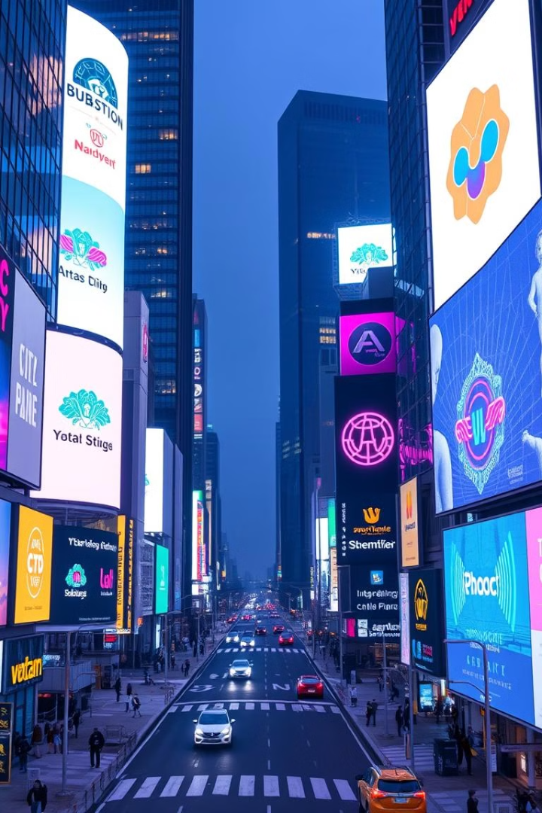
The Future of Logo Design
Logo Craft is leading the way in democratizing access to professional-quality logo design. Try it today and unleash the creative potential of AI for your brand!

